Slide 1
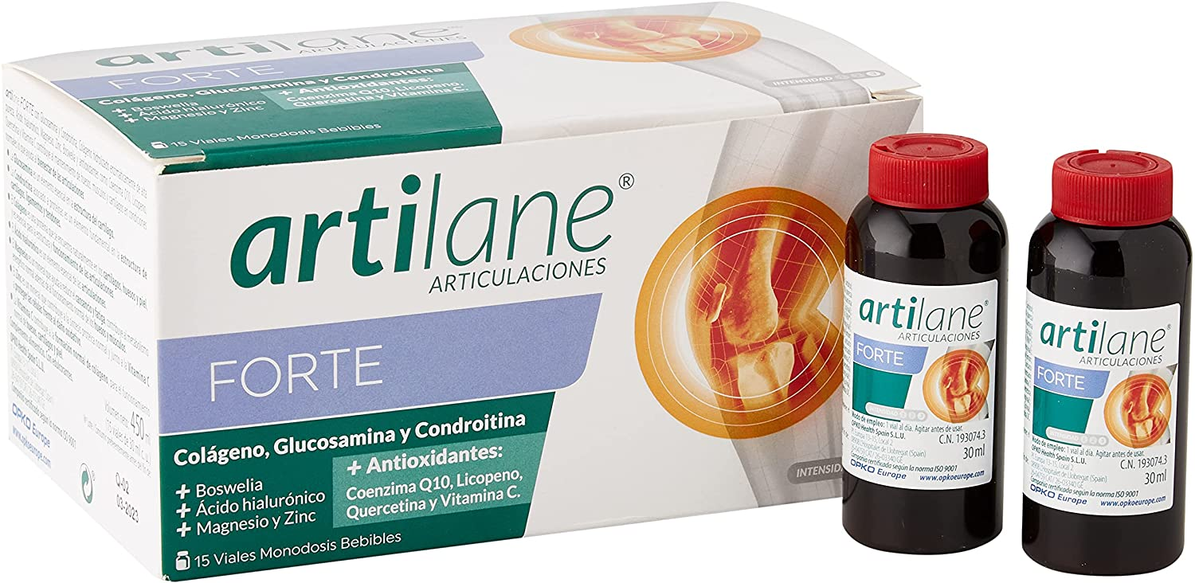
Artilane Forte (Drinkable Vial (15 Vial)
Vial (drinkable ) | Enzymatic Hydrolysed Collagen of high purity | Vial (drinkable solution (box contain 15 single dose vials ) 30 ml | Neohesperidine DC with Sucralose +Flavored by (Pineapple + Lemon)-caramel colour
 | Glucosamin chlorohydrate
 | Chondroitin Sulphate
 | Lycopene
 | Hyaluronic acid
 | Coenzyme Q10
 | Quercetin
 | Vitamin C
 | Magnesium
 | Boswellia (AKBE)
 | Zinc

